Slide 1
Advanced geometries in metallic fuel
Khadija Mahbuba
Graduate Student
Department of Nuclear Engineering
North Carolina State University

Slide 2
OUTLINE
Background
Advanced geometries of metallic fuel
Annular fuel slug
Slotted fuel slug
Helical fuel rod
Conclusion

Slide 3
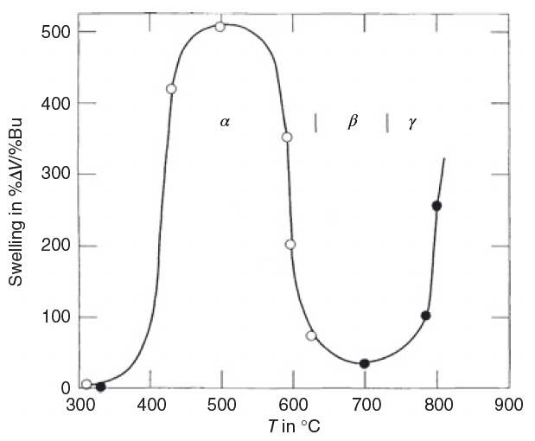
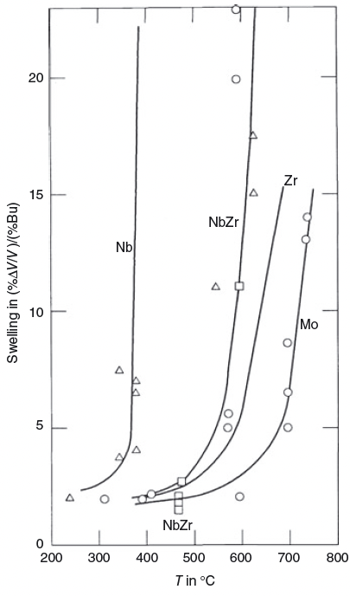
BACKGROUND
Initial metallic fuel designs attempted to irradiate solid fuel slugs that were tightly bonded to their cladding, but fission gas-induced swelling lead to cladding breaches at burnups below 3% fissions per initial heavy metal atom (FIMA) due to fuel-cladding mechanical interaction. This leads to various new concepts, including decreased smear density and an increased plenum size to accommodate fission gas release.
Incorporating these new concepts, results in an increase of FIMA to 10%, compared to PWR (~6%FIMA). So, better fuel economics.
High degree of swelling (compared to ceramic U) observed in low alloy (~10wt% Zr) metal fuels is primarily due to the presence of alpha-phase U.
To stabilize cubic gamma phase Zr, Mo, Nb alloying elements are used. Higher operating temperatures result in more swelling.

Slide 4
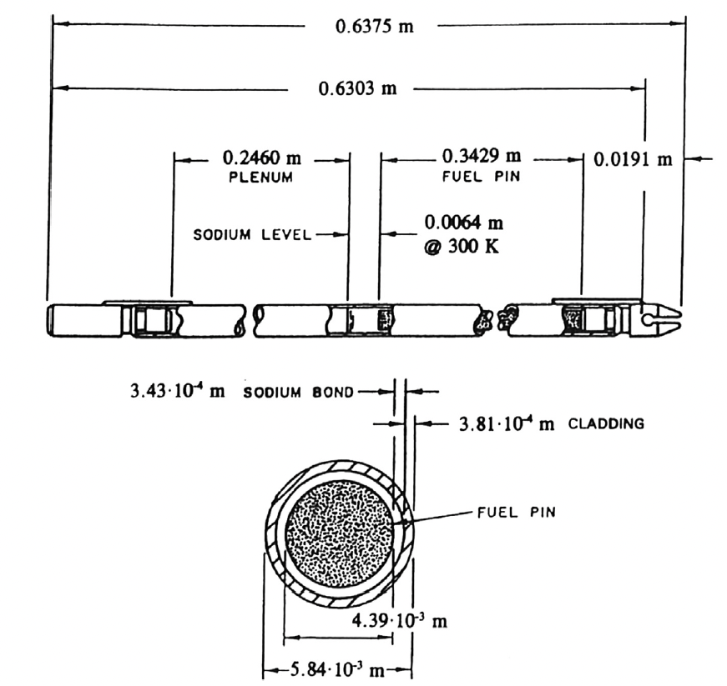
Figure : typical metallic fuel rod geometry utilized in EBR II
BACKGROUND
Better heat transfer medium like Na in the gap area. Na- bond does not allow to send spent fuel to respiratory without recycling, though it helps to increase overall thermal conductivity of the system.
To explore the Na replacement, attain higher burnup, utilizing metallic fuel in LWR concept, many fuel geometry and compositions are studied in literature. For example, heterogenous core, annular, slotted fuel geometry, helical fuel rod.

Slide 5
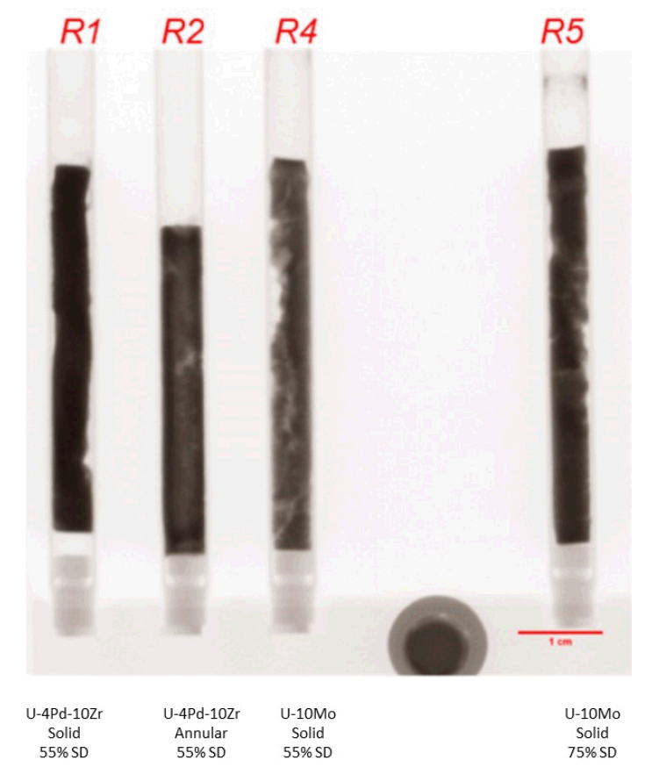

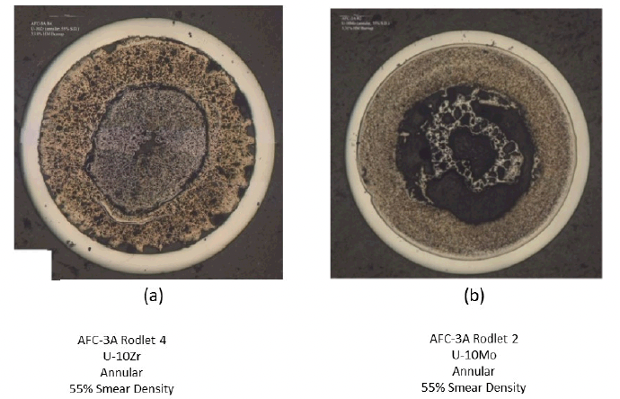

ANNULAR METALLIC FUEL DESIGN
Typical smearing density in solid fuel slug is 75%. But why?
Solid fuel slug (U-4Pd-10Zr) with lower smearing density shows an extensive axial deformation, lift off in bonded Na and asymmetric distribution of fuel.
Annular fuel with Na bond shows the opposite behaviors
To reduce the disposal cost, bond Na free annular fuel has potential to be utilized in one-through metallic fast reactor.
Annular Na free U-10Zr performed better than U-10Mo.
To ensure the effective transport of thermal energy from the fuel to the coolant, either a He bond or a mechanical bond is required.
Moreover, protective liner is necessary to reduce FCCI.

Slide 6
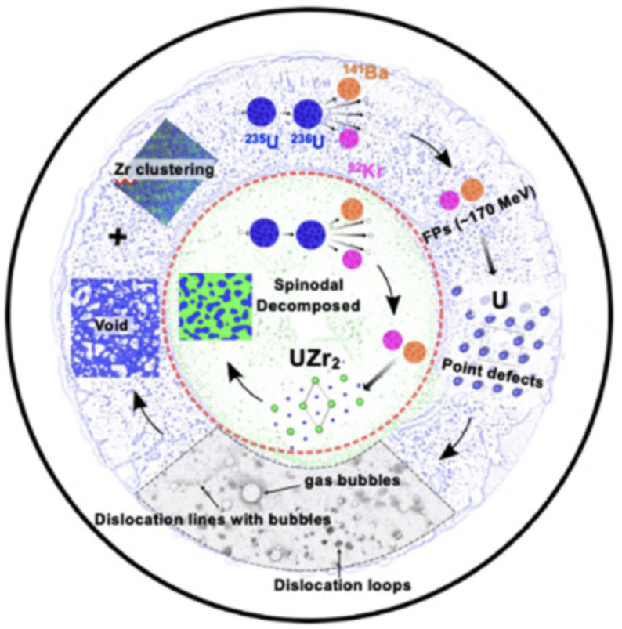
ANNULAR METALLIC FUEL DESIGN
Apart from lower thermal conductivity, extremely tight tolerance of fuel outer and cladding inner diameter is required.
Though Na-free annular fuel is designed to attain 30% FIMA, After insertion into ATR, it was found that the cladding did not have uniform inner walls, creating larger gaps between the fuel and cladding than anticipated, creating higher peak inner cladding temperatures than expected (2020).
Post-irradiation examination (PIE) of this pin shows the microstructure was significantly altered during irradiation. The original annular region is depleted in Zr and became highly porous, while the center part is much denser and enriched in Zr.

Slide 7
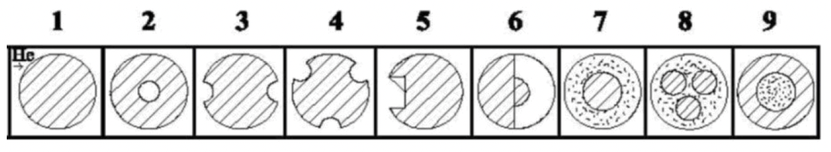
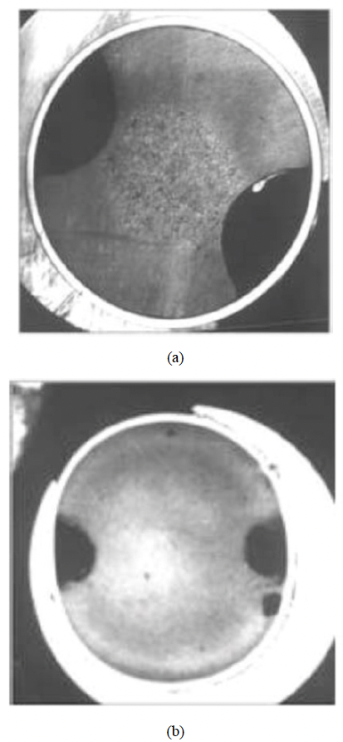
SLOTTED METALLIC FUEL DESIGN
Most of the research are conducted by Research Institute of Atomic Reactors [RIAR], Russia for BN reactor.
Na bond is not possible because the gas plenum is located below the fuel column.
Furthermore, heterogenous fuel rod design (oxide and metallic fuel) has been studied.
Ovalization of the fuel rod was observed for 2slot design.
So, there is a concern associated with slotted fuel designs include distortion of the fuel pin because of the non-uniform pressure exerted by the fuel onto the cladding and the potential for increased axial growth when compared to an annular design

Slide 8
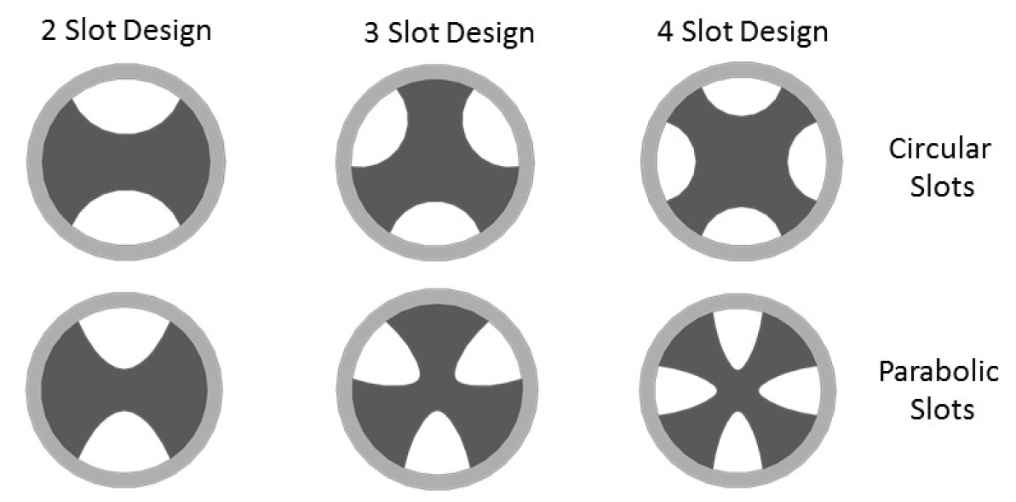
SLOTTED METALLIC FUEL DESIGN
From a fuel performance perspective, more symmetric slot arrangements and deeper but narrower slots are likely to be preferred to both minimize cladding distortion and to limit fuel axial growth.
In addition to this, the fabrication of annular fuel in a hot cell is judged to be difficult, while slotted fuel designs can likely be manufactured by casting.
These designs are expected to use fuels with a high heavy metal density such as pure uranium or uranium-plutonium alloys to compensate for low smear density 60 percent smear density
As alloying element, alloys that increase the fuel solidus temperature would allow for larger diameter pins.
No results has been published yet.

Slide 9
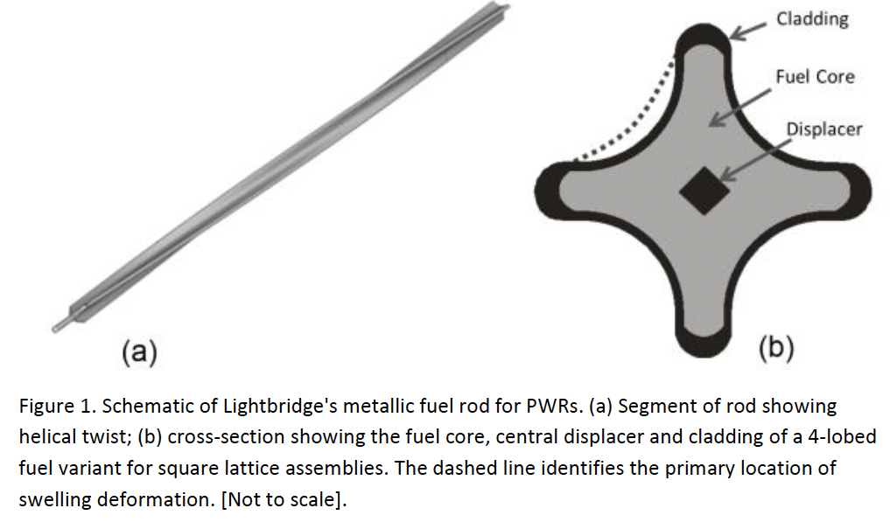
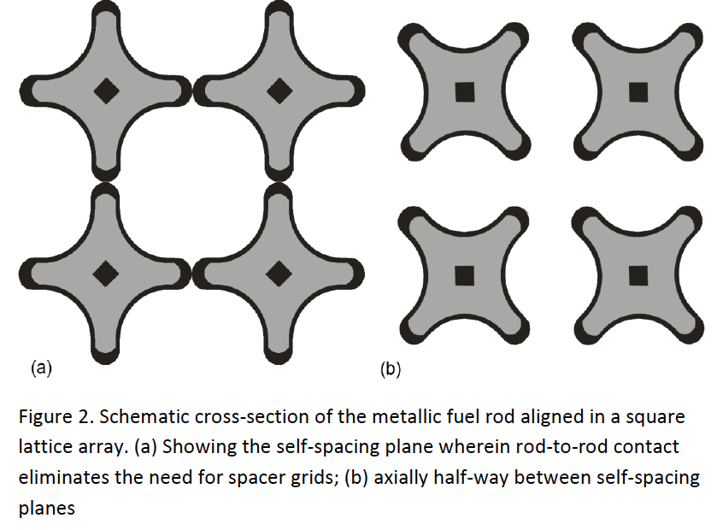
LIGHTBRIDGE CORPORATION’S ADVANCED METALLIC FUEL
Multilobed, helical geometry, monolithic fabrication
The fuel core is a Zr-U alloy with Zr content near 50 wt%. The fuel cladding and central displacer are made from a Zr-1Nb alloy with high corrosion resistance in LWR environments. Central displacer lowers the centerline fuel temperature and increases the thermal conductivity in the center.
Helical twist increases surface area for heat transfer by ~40% as well as turns the entire fuel column into a mixing vane and reduces the likelihood of hot spots developing in the fuel.
Fuel rod contacts adjacent rods at multiple planes along the assembly length, eliminating the need for spacer grids as the rods are self-spacing.
The cladding is thicker at the outer edge of the lobes to provide additional protection against fuel damage due to cladding fretting wear at the contact points.

Slide 10
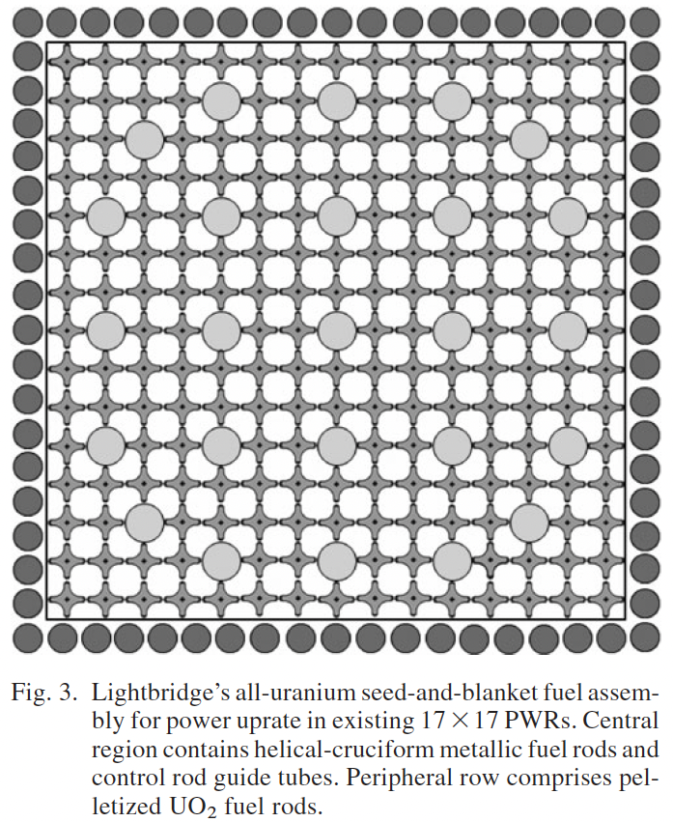
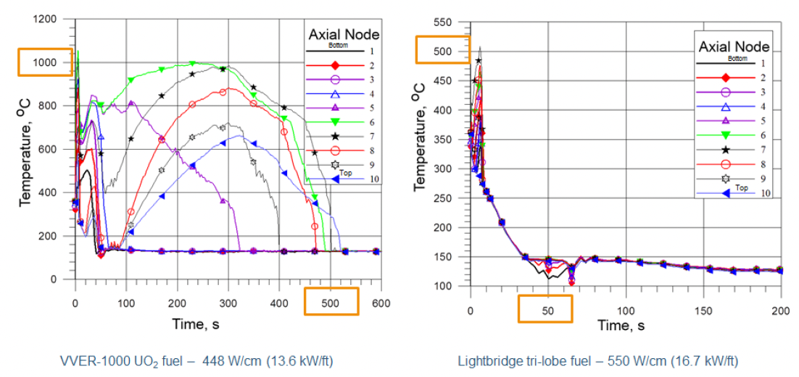
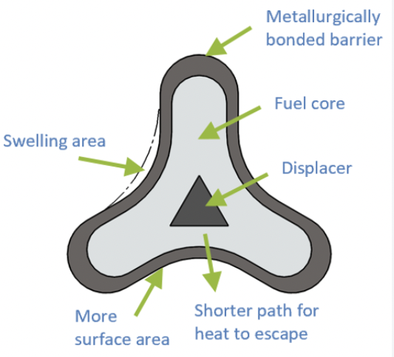
LIGHTBRIDGE CORPORATION’S ADVANCED METALLIC FUEL
Radiation-induced swelling occurs primarily in the interior region of the fuel lobes, resulting in an expansion of the central region and lobe thickness of the fuel rod.
The low fuel operating temperature inhibits diffusion-controlled mechanisms such as fission gas atom mobility resulting in fission gases behaving similarly to solid fission products.
This fuel assembly is capable of increasing the power output of an existing Westinghouse-type four-loop PWR by up to 17% with a planned 24-month operating cycle, also better performance during LOCA.

Slide 11
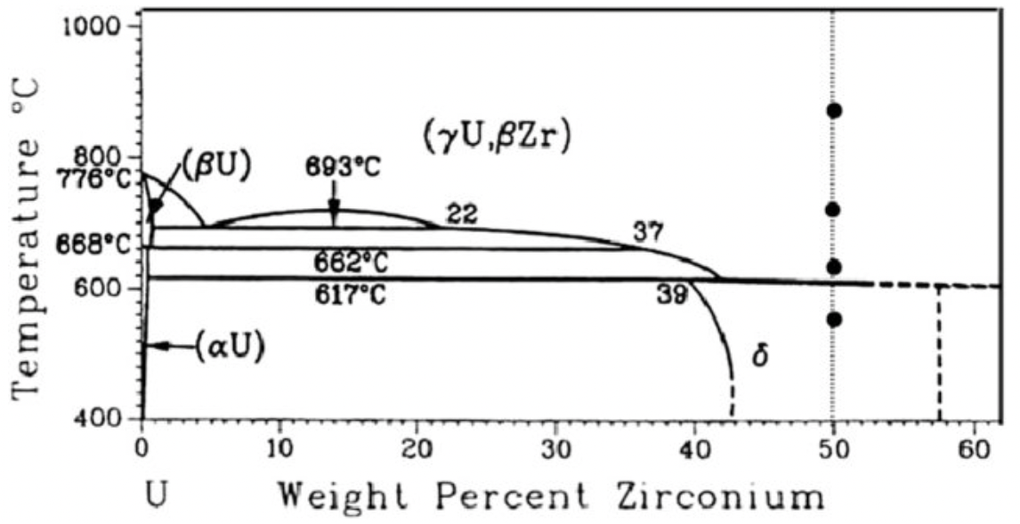
LIGHTBRIDGE CORPORATION’S ADVANCED METALLIC FUEL
Though the fabrication of delta- phase is easy, it undergoes a spinodal-like phase decomposition in a U-50Zr alloy by thermal annealing at 620 deg C and ion irradiation at 550 deg C.
The high Zr content reduces the uranium loading per unit volume to about one-half that of UO2. Therefore, the metallic fuel requires increased enrichment to compensate for reductions in both the initial fissile loading and the fissile plutonium generated during reactor operation. Lightbridge is currently developing the metallic fuel with 235U enrichment of up to 19.7 wt%.

Slide 12
CONCLUSION
New design concept are required to get better fuel economics. Moreover, to replace UO₂ fuel by metallic fuel due to their high burnup and inherent safety features (Lightbridge corporation’s advance fuel design).
U-10Zr annular fuel accommodated dramatic swelling by an inward swelling mechanism with little fuel cladding strain. Thus, it demonstrates the potential of replacing a Na bonded solid fuel with a He bonded annular fuel design.
Need the development of zirconium and/or vanadium liners for Na - bond free designs.
In USA based design, annular fuel without Na-bond might be used in one-through reactor system, whereas slotted fuel with Na bonding in recycling fuel system.
Delta- UZr₂ undergoes spinodal-like phase decomposition. Delta- UZr₂ phase can be found both in annular, helical design.

Slide 13
THANK YOU

